Slide 1
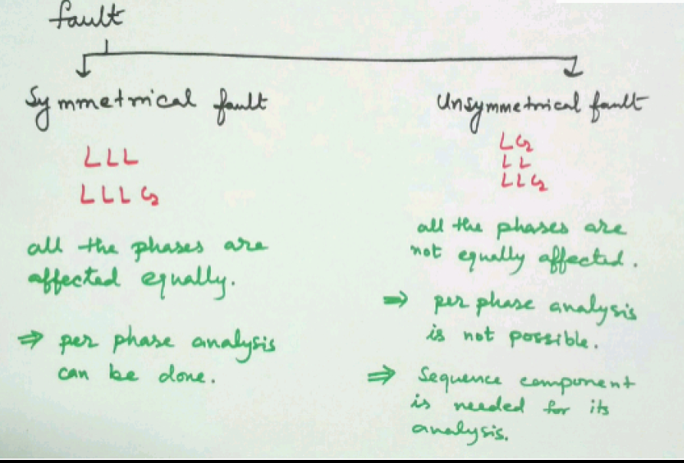

Slide 2
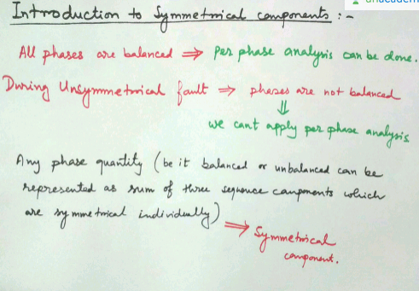

Slide 3
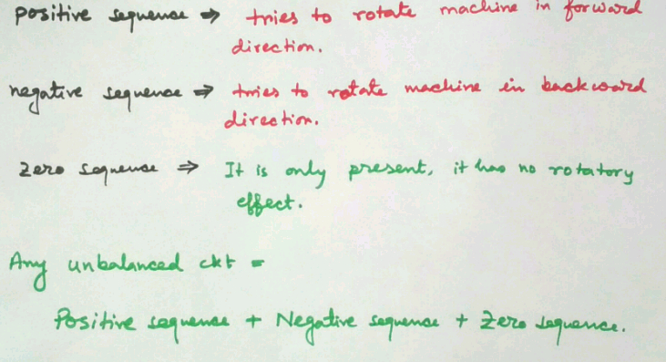

Slide 4
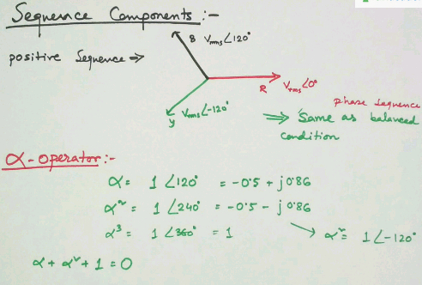

Slide 5
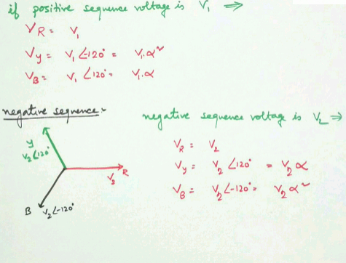

Slide 6
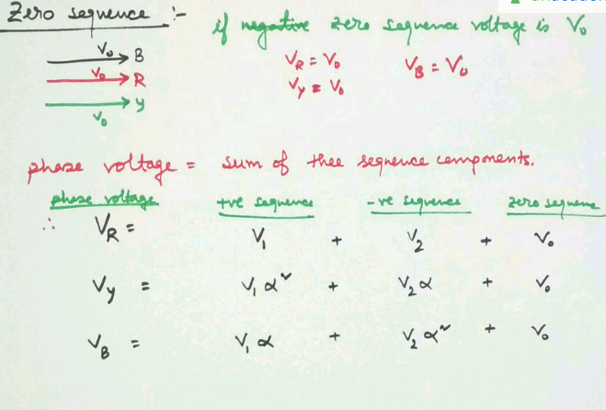

Slide 7
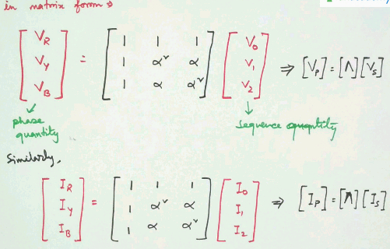

Slide 8
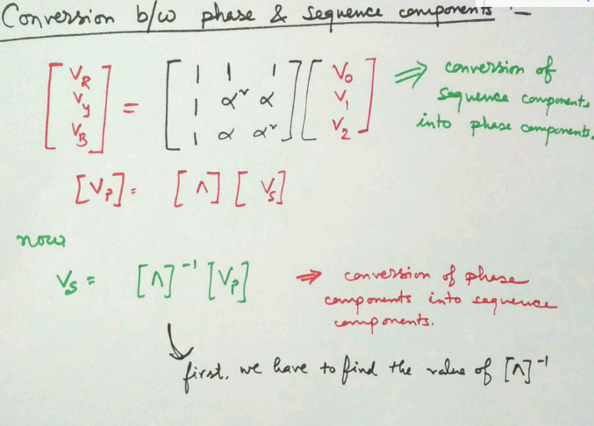

Slide 9
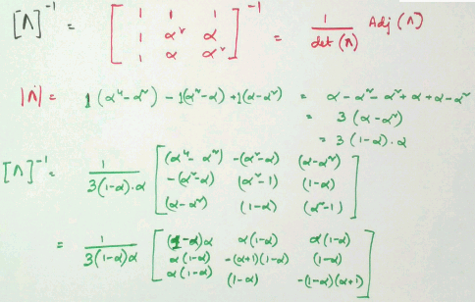

Slide 10
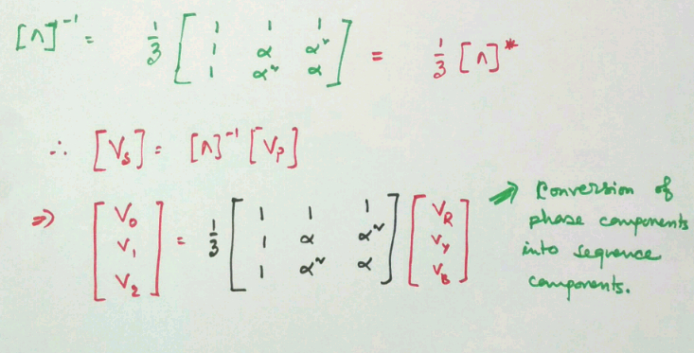

Slide 11
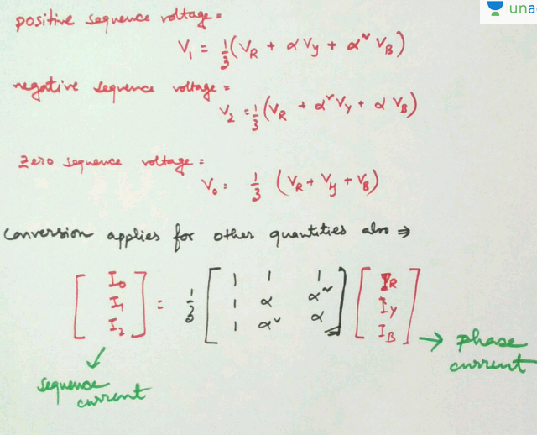

Slide 12
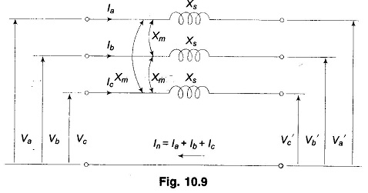
Sequence Impedances of Transmission Lines:
Sequence Impedances of Transmission Lines – Figure shows the circuit of a fully transposed line carrying unbalanced currents. The return path for I_{n} is sufficiently away for the mutual effect to be ignored.
Let
X_{s} = self reactance of each line
X_{m} = mutual reactance of any line pair

Slide 13
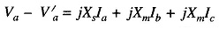
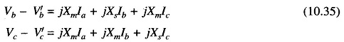
The following KVL equations can be written down from Fig

Slide 14
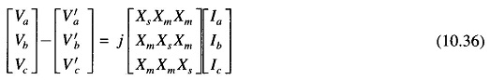
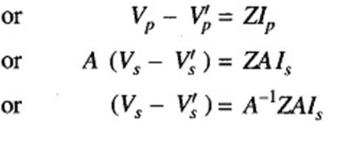
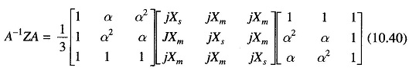
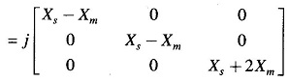

Slide 15
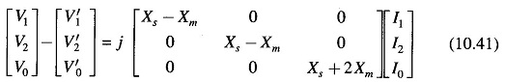
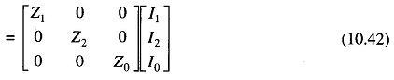
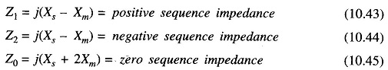
We conclude that a fully transposed transmission has:
equal positive and negative Sequence Impedances of Transmission Lines.
zero sequence impedance much larger than the positive (or negative) Sequence Impedances of Transmission Lines (it is approximately 2.5 times).

Slide 16
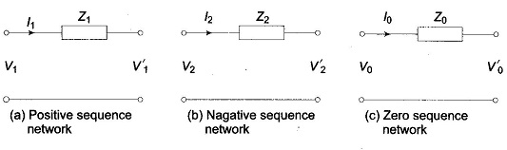
It is further observed that the sequence circuit equations are in decoupled form, i.e. there are no mutual sequence inductances. Equation can be represented in network form as in Fig.

Slide 17
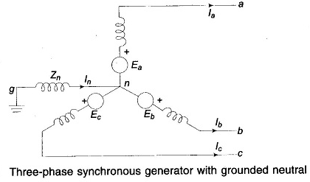
Sequence Impedances and Networks of Synchronous Machine:
Sequence Impedances and Networks of Synchronous Machine – Figure depicts an unloaded synchronous machine (generator or motor) grounded through a reactor (impedance Z_{n}).
E_{a},E_{b} and E_{c} are the induced emfs of
the three phases. When a fault
(not shown in the figure) takes place at
machine terminals, currents I_{a,} I_{b} and I_{c}
flow in the lines.
Whenever the fault involves ground,
current I_{n} = I_{a} + I_{b}+ I_{c} + flows to neutral
from ground via Z_{n}.
Unbalanced line currents can be resolved into their symmetrical components I_{a1,} I_{a2} and I_{a0}.
Before we can proceed with fault analysis, we must know the equivalent circuits presented by the machine to the flow of positive, negative and zero sequence currents, respectively. Because of winding symmetry currents of a particular sequence produce voltage drops of that sequence only. Therefore, there is a no coupling between the equivalent circuits of various sequences.

Slide 18
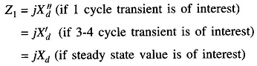
Positive Sequence Impedance and Network:
Since a synchronous machine is designed with symmetrical windings, it induces emfs of positive sequence only, i.e. no negative or zero sequence voltages are induced in it. When the machine carries positive sequence currents only, this mode of operation is the balanced mode. The armature reaction field caused by positive sequence currents rotates at synchronous speed in the same direction as the rotor, i.e., it is stationary with respect to field excitation. The machine equivalently offers a direct axis reactance whose value reduces from subtransient reactance (X”_{d}) to transient reactance (X′_{d}) and finally to steady state (synchronous) reactance (X_{d}), as the short circuit transient progresses in time. If armature resistance is assumed negligible, the positive Sequence Impedances and Networks of Synchronous Machine is

Slide 19
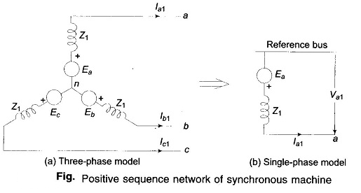
Figure shows the three-phase positive sequence network model of a synchronous machine. Z_{n} does not appear in the model as I_{n} = 0 for positive sequence currents. Since it is a balanced network it can be represented by the single-phase network model of Fig. for purposes of analysis. The reference bus for a positive sequence network is at neutral potential. Further, since no current flows from ground to neutral, the neutral is at ground potential.
the positive sequence voltage of terminal a with respect to the reference bus is given by

Slide 20
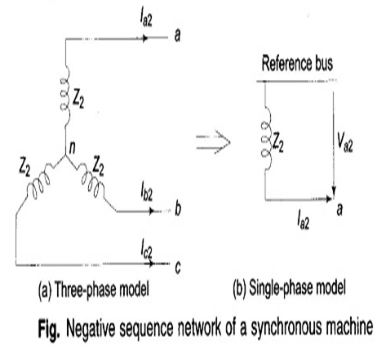
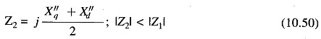
Negative Sequence Impedance and Network:
With the flow of negative sequence currents in the stator a rotating field is created which rotates in the opposite direction to that of the positive sequence field and, therefore, at double synchronous speed with respect to rotor. Currents at double the stator frequency are therefore induced in rotor field and damper winding. In sweeping over the rotor surface, the negative sequence mmf is alternately presented with reluctances of direct and quadrature axes. The negative Sequence Impedances and Networks of Synchronous Machine with consideration given to the damper windings, is often defined as
Negative sequence network models of a synchronous machine, on a three-phase and single-phase basis are shown in Figs. The reference bus is of course at neutral potential which is the same as ground potential.
The negative sequence voltage of terminal a with respect to reference bus is

Slide 21
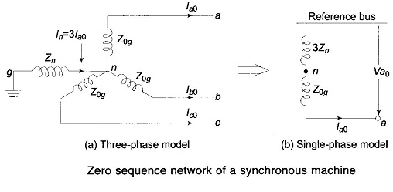
Zero Sequence Impedance and Network:
We state once again that no zero sequence voltages are induced in a synchronous machine. The flow of zero sequence currents creates three mmfs which are in time phase but are distributed in space phase by 120°. The resultant air gap field caused by zero sequence currents is therefore zero. Hence, the rotor windings present leakage reactance only to the flow of zero sequence currents (Z_{0g} < Z₂ < Z₁).
Zero sequence network models on a three- and single-phase basis are shown in Fig. the current flowing in the impedance Z_{n} between neutral and ground is I_{n} = 3I_{a0.} The zero sequence voltage of terminal a with respect to ground, the reference bus, is therefore

Slide 22
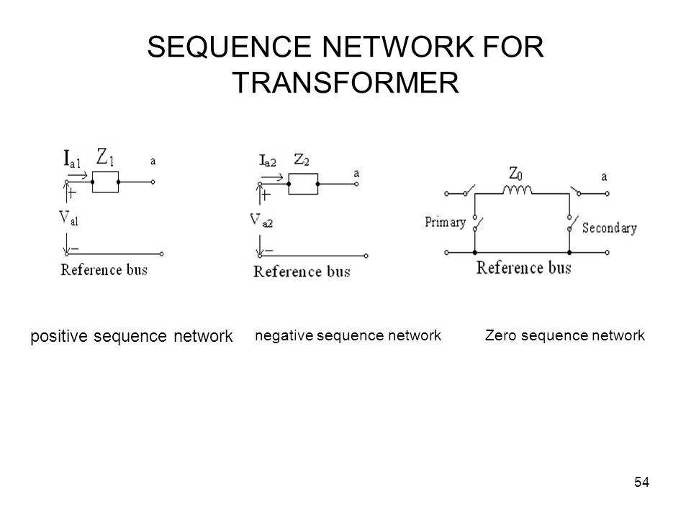

Slide 23
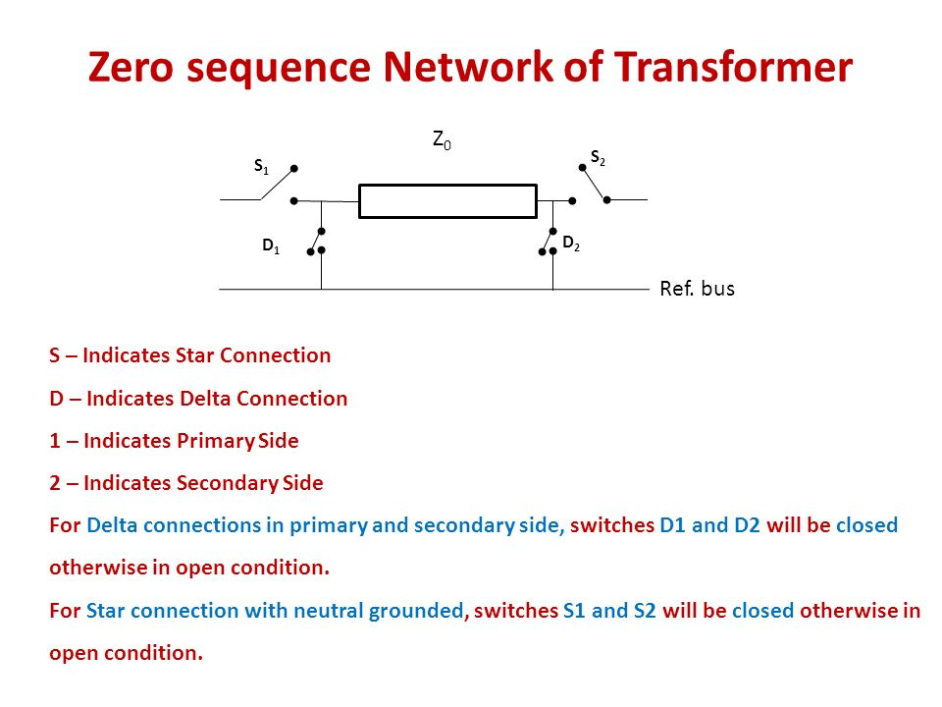

Slide 24
